Slide 1

Aware Super
Technology Intern – Solutions Delivery Department
Frontend Developer
Name: Alisha Shewale
Manager: Vishal Sharma
Buddy: Hashim Raza
16th February 2022

Slide 2
About me
Education
Masters of Information technology
University of Melbourne
Previous work
Intern at OMC international (Maritime Industry)
One year as software Developer at Cybershines technologies Pvt Ltd (IN)

Slide 3

Highlights and challenges
Highlights
Intern Networking Meeting
Learning and Development workshops
Daily standup meetings
Challenges
Naïve to new Technology
Time taken for research
Trail and error in hero function
Struggle with time management.

Slide 4

Achievements
Learned Effective Oral Communication
Learned how to efficiently manage time by prioritizing tasks
Improved my Problem solving and research skills

Slide 5

Learning and Projects
Agile Methodology
Technical skills developed
HTML,
CSS, SCSS, and Flexbox
Javascript, jQuery
Bootstrap
Projects developed
Develop replica of part of Aware website
Index Navigation
Product Selector Carousel

Slide 6
1. Replica of part of Aware website

Slide 7
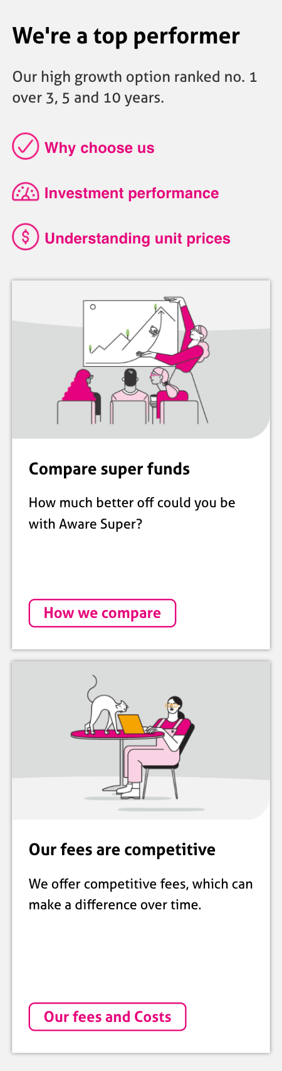
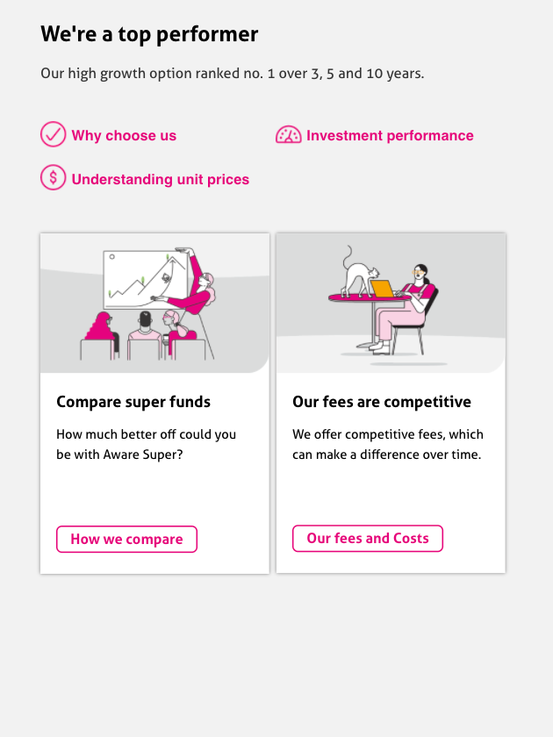
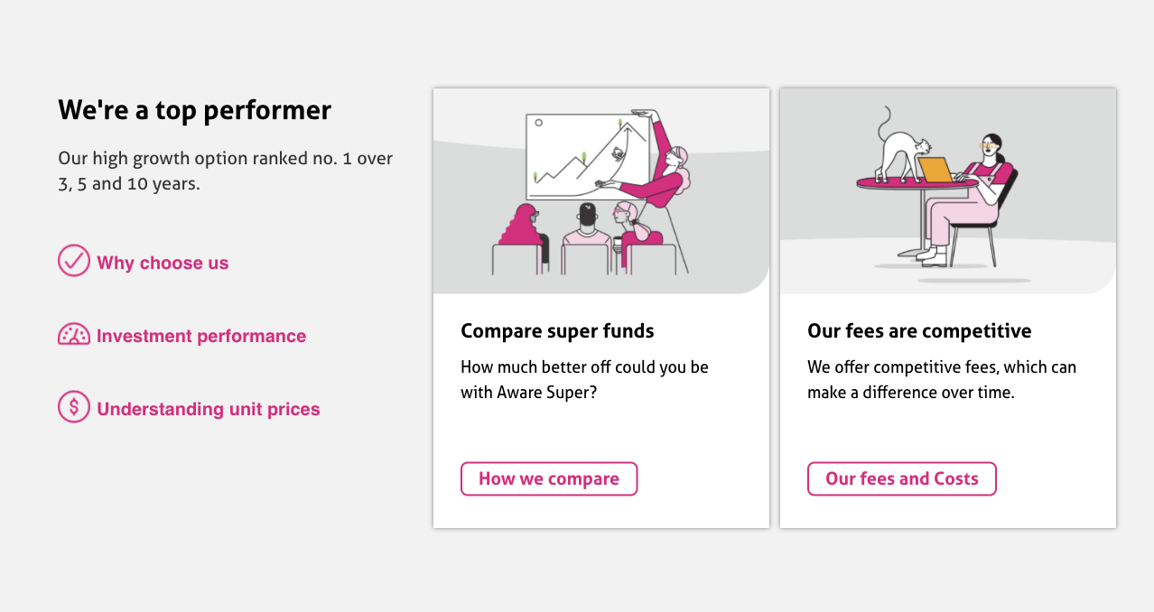
Desktop View | Tablet View | Mobile View

Slide 8
2. Index Navigation

Slide 9
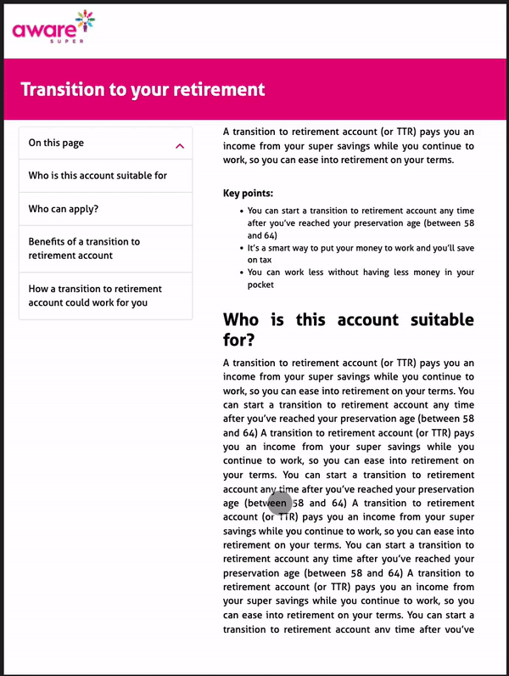
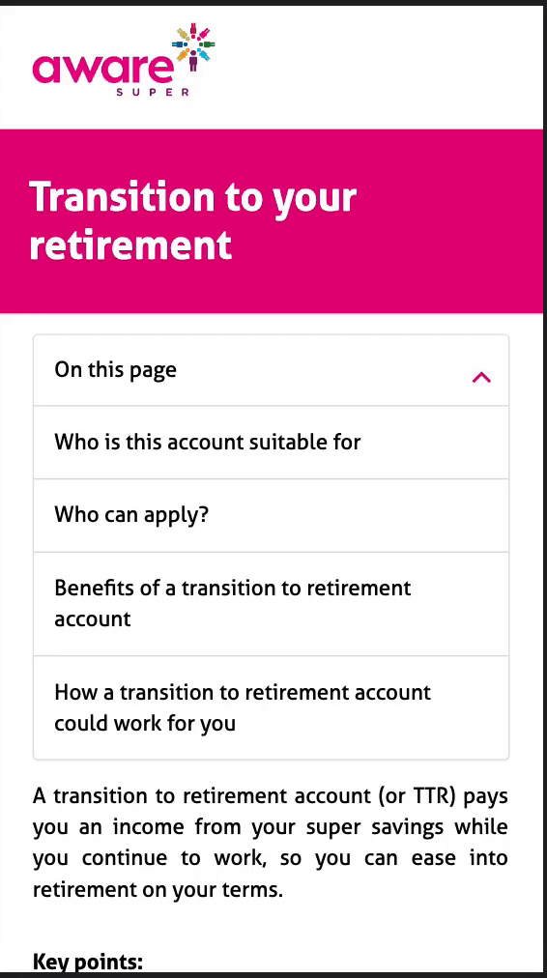
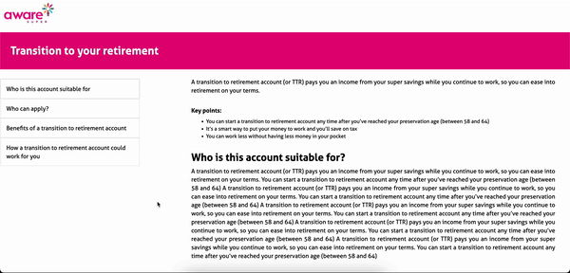
Desktop View | Tablet View | Mobile View

Slide 10
3. Product Selector Carousel

Slide 11
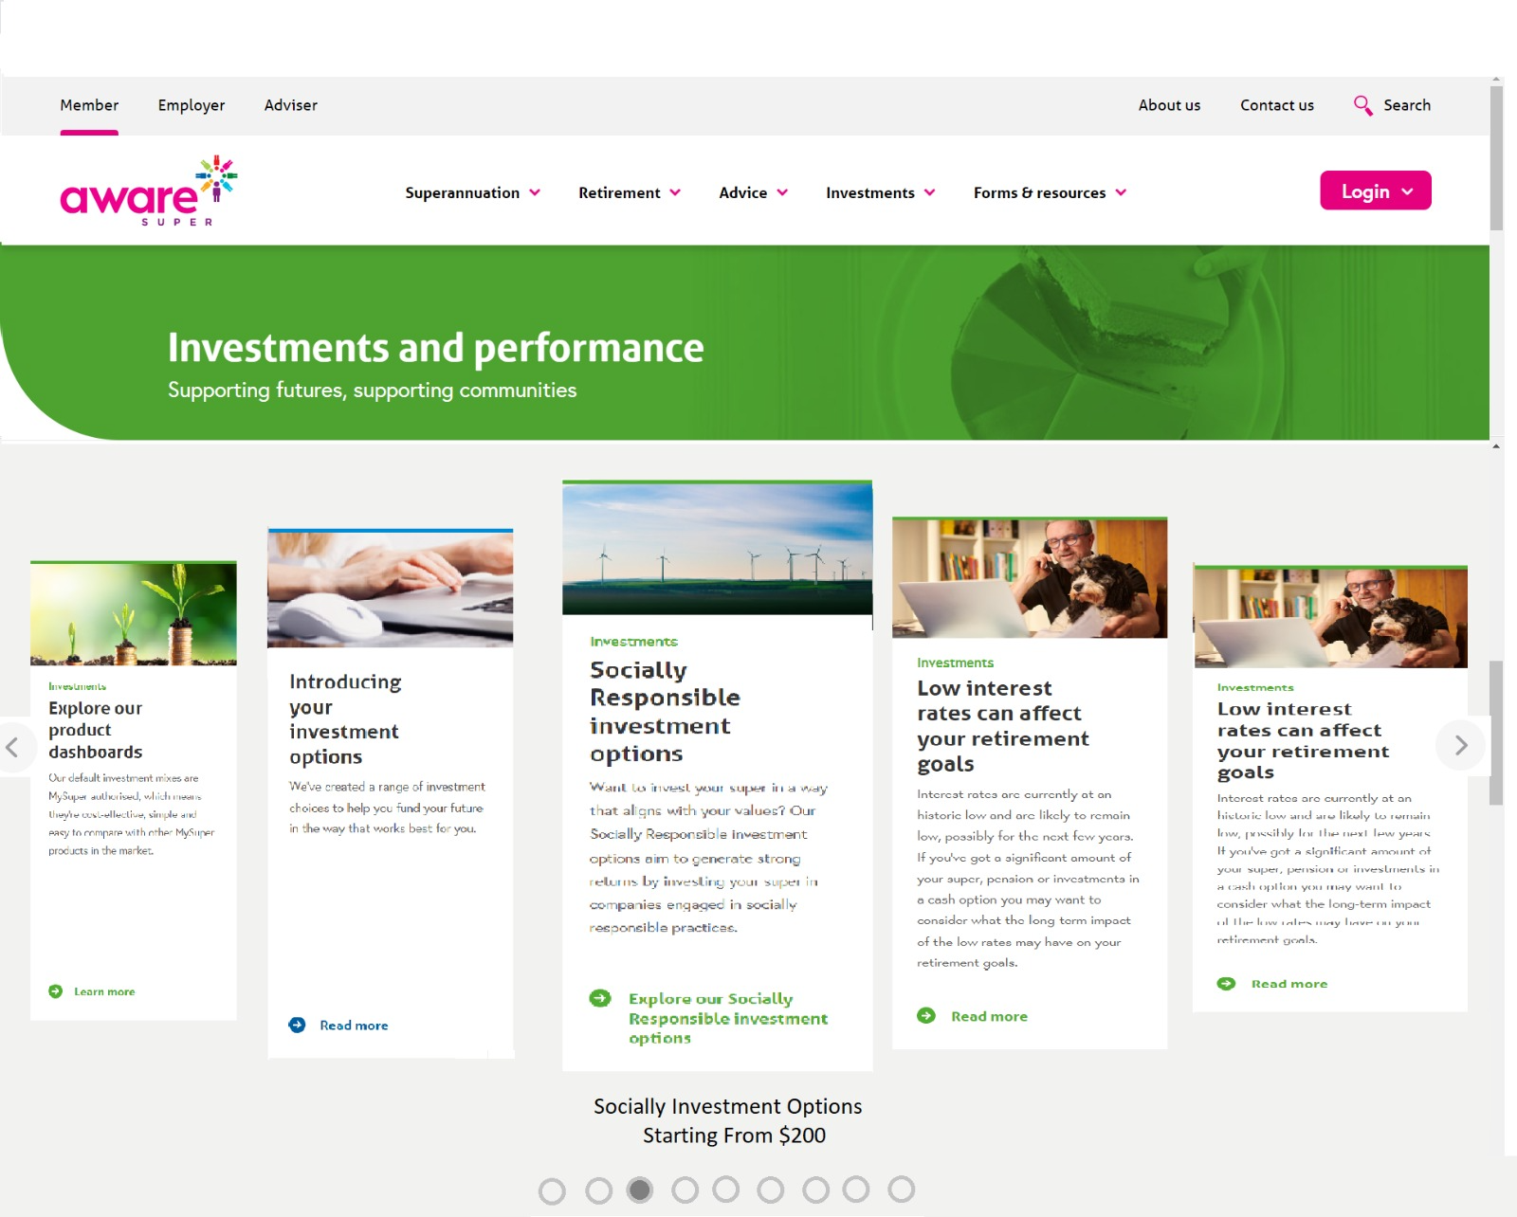
Design for the slider

Slide 12

Research undertaken for development
Analyzing the requirement.
Brainstorming the design.
Gathering and implementing the
resources for carousel.
Glide js (JS slider and carousel)
Not responding on mouse pointer movement.
Owl carousel js (jQuery plugin)
Malfunctioned plugin
Swiper js (modern touch slider)
Successfully implemented the carousal.

Slide 13
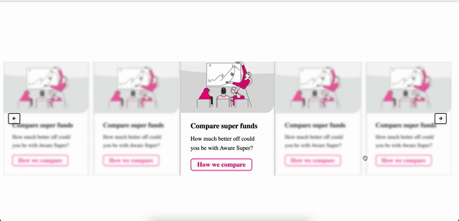
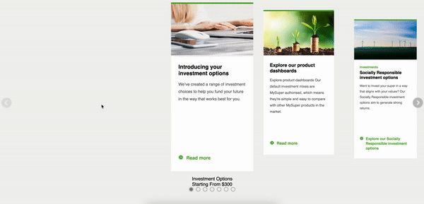
Version 1
Version 2

Slide 14
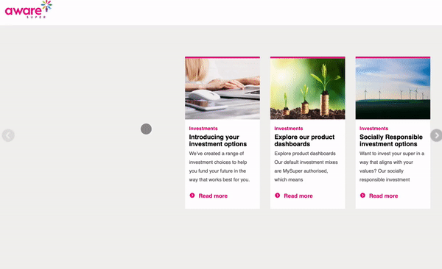
Version 3

Slide 15
Final Version - Demo

Slide 16

Thank You
Any Questions?

